Slide 1
Graph Convolution Neural Network (GCNN)

Slide 2
Traditional Neural Networks

Slide 3
Graph-structured Data
A lot of real-world data does not “live” on grids
Standard CNN and RNN architectures don’t
work on this data

Slide 4
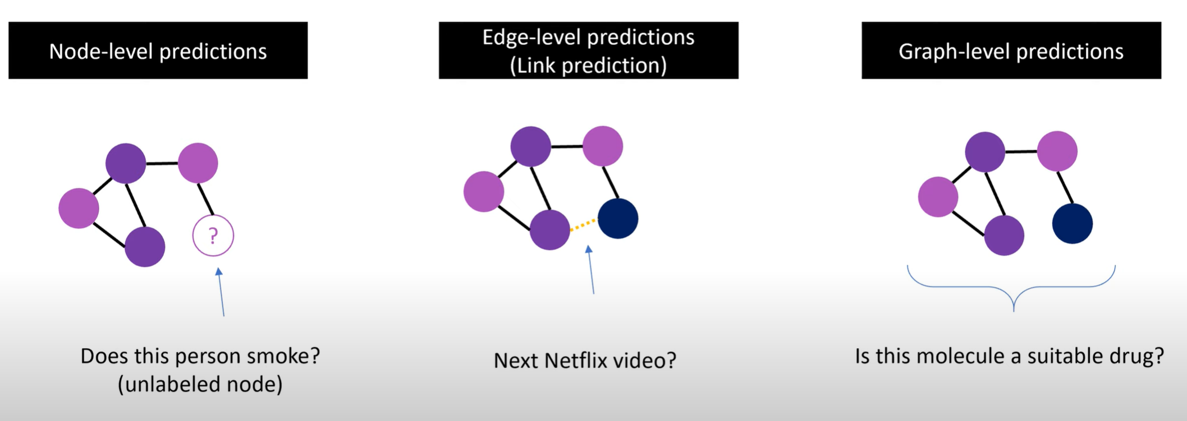
Example for Machine Learning problem for Graph Data

Slide 5
Applications of GCNN
• Network Analysis
1. Node classification
2. Link prediction
3. Matrix completion
• Molecular Applications
1. Neural molecular fingerprint
2. Quantitative Structure-Property Relationship (QSPR)
3. Molecular generative model
• Interacting physical system

Slide 6
A Brief History of Graph Neural Nets

Slide 7
Graph Convolutional Networks (GCNs)
Main Idea: Pass massages between nodes to refine node (and possibly edge) representations

Slide 8
Graph Convolutional Networks (GCNs)

Slide 9
Convolutional Neural Networks (CNNs)

Slide 10
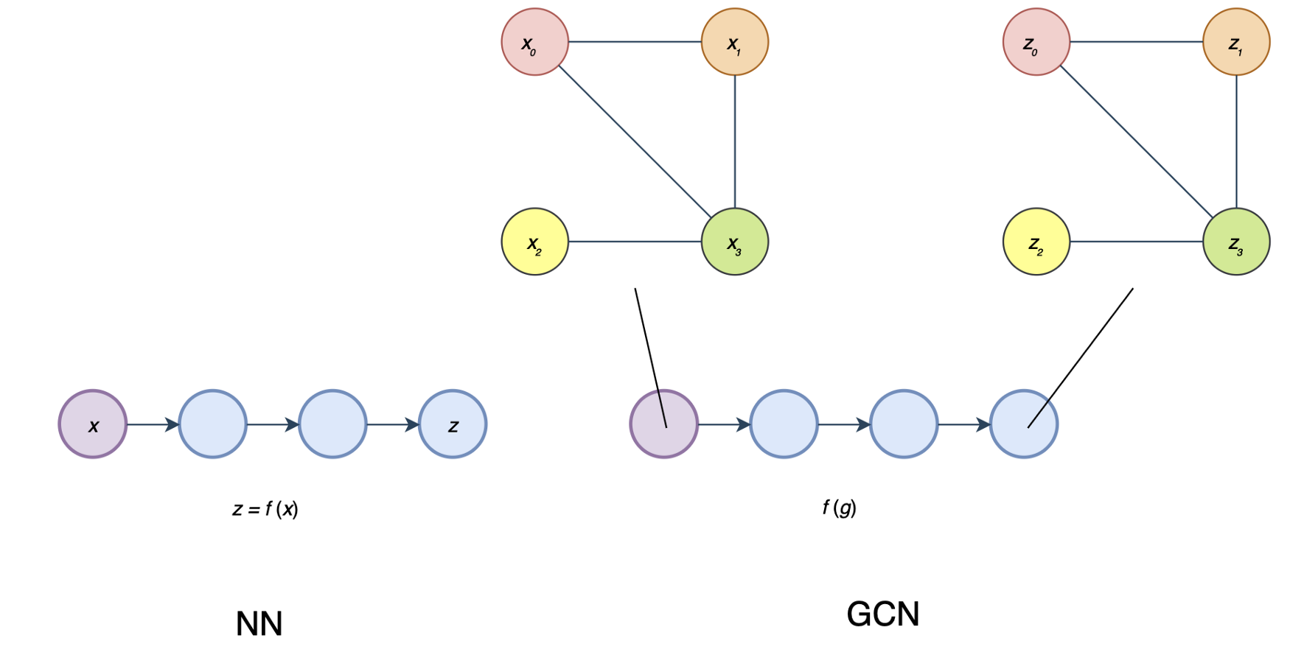
Graph Convolutional Networks (GCNs)
Kipf & Welling (ICLR 2017), related previous works by Duvenaud et al. (NIPS 2015) and Li et al. (ICLR 2016)

Slide 11
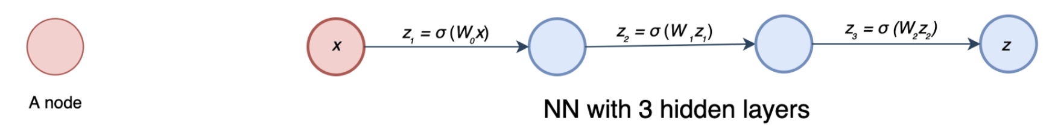
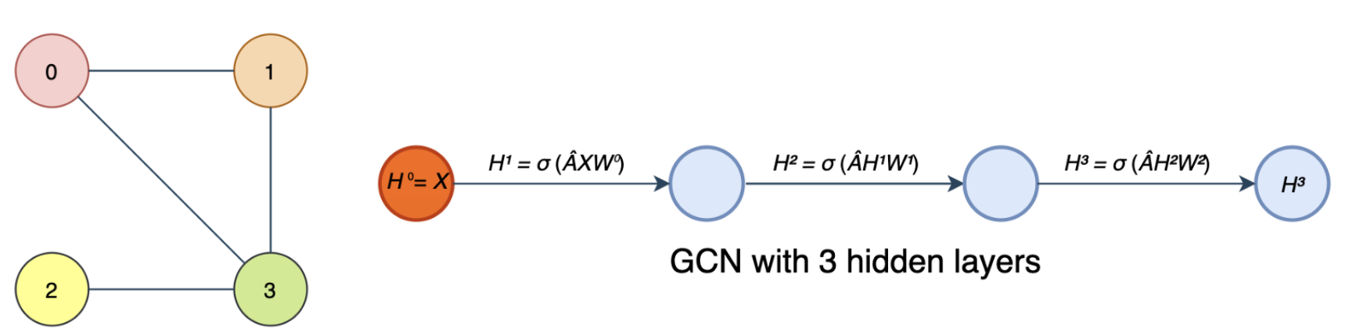
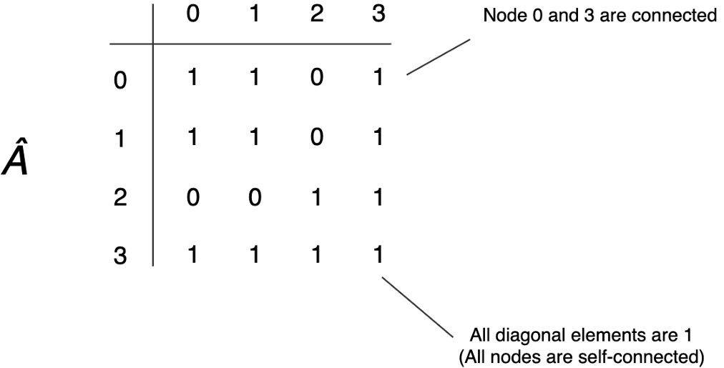
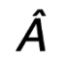
Graph Convolutional Networks (GCNs)
A Graph
Is the normalized version of A where A is the adjacency matrix

Slide 12
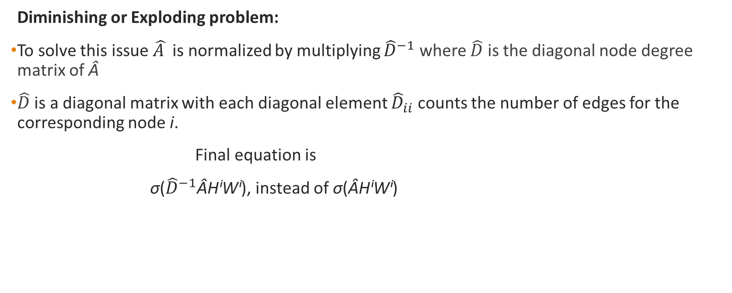
Practical issues of Graph Convolutional Networks (GCNs)
Diminishing or Exploding problem:
To solve this issue $\hat{A }$is normalized by multiplying ${\hat{D}}^{−1}$ where $\hat{D}$ is the diagonal node degree matrix of Â
$\hat{D}$ is a diagonal matrix with each diagonal element ${\hat{D}}_{ii}$ counts the number of edges for the corresponding node i.
Final equation is
σ(${\hat{D}}^{−1}$ÂHⁱWⁱ), instead of σ(ÂHⁱWⁱ)
Propagation Rule
the degree of a node is counted as the number of times an edge terminates at that node. So a self-loop will count twice.

Slide 13
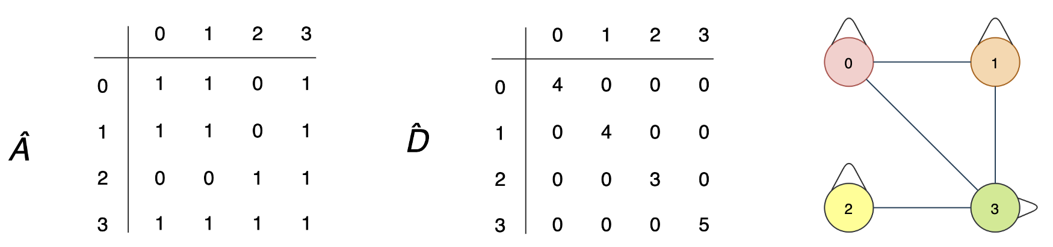

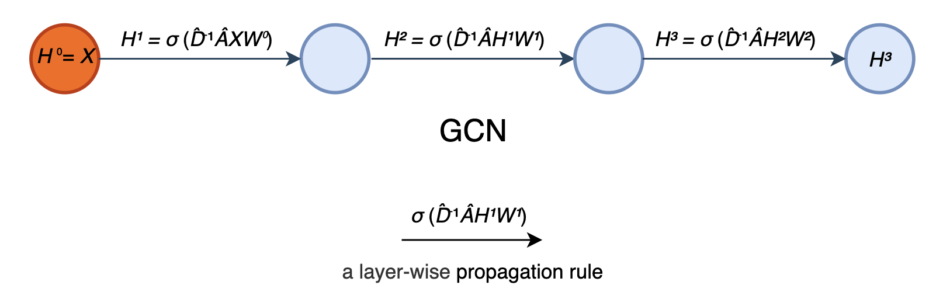
Example
Node 0 has 2 edges connecting to its neighbors plus a self-loop.
Its degree equals 4 (i.e. 2 + 2). For node 3, its degree equals 5 (3 + 2).
Propagation Rule

Slide 14
Dropout
# parameters: 4x4 = 16
# parameters: 4x4 = 16
# parameters: 16x0.75 = 12
# parameters: 16x0.75x0.75 = 9

Slide 15
Dropout
Hidden states in a graph neural network

Slide 16
Dropout
And many other options are possible. The proper method depends on your task.

Slide 17
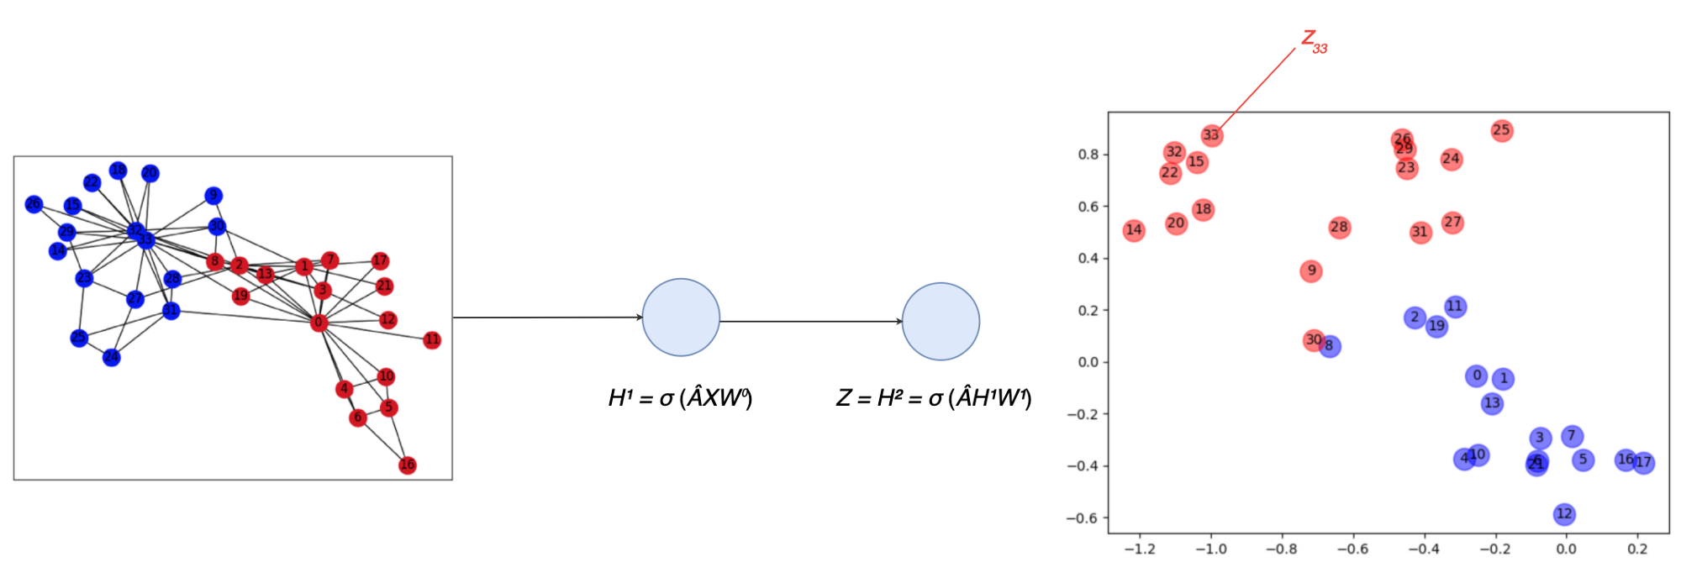
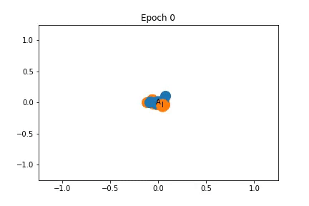
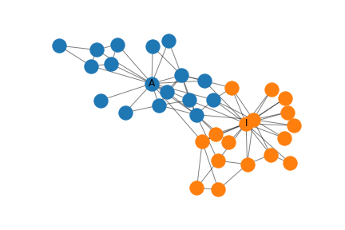
Example:Zachary’s karate club
Input: Social graph with labels
Output: The task is to predict which side of the conflict each member of the karate club chooses (Node classification).
Administrator and Instructor
Kipf, Thomas N., and Max Welling.
"Semi-supervised classification with graph convolutional networks." arXivpreprint arXiv:1609.02907 (2016)
http://tkipf.github.io/graph-convolutional-networks/

Slide 18
Architecture of Graph Neural Networks
Graph Convolutional Network (GCN)
Graph Attention Network (GAT)
Gated Graph Neural Network (GGNN)
Graph Auto-Encoders

Slide 19
Graph Attention Network (GAT)
Monti et al. (CVPR 2017), Hoshen (NIPS 2017), Veličković et al. (ICLR 2018)

Slide 20
Graph Auto-Encoders
Link prediction
Clustering
Matrix completion and recommendation

Slide 21



GCNN Tools
William L. Hamilton McGill University 2020, Graph Representation Learning, https://www.cs.mcgill.ca/~wlh/grl_book/

Slide 22

Thank You

